Slide 1
Harvesting Logs for Enhanced Investigations
I <3 Logs
David Gainey
DISA Incident Response Team
9 JAN 2019

Slide 2
Who Am I?
Computer Scientist
Herald of Hunting
Incident Responder for 10+ years with DISA

Slide 3
Collect
What is the most valuable resource for incident response?
Historical data; typically in the form of logs
What should be centralized?
Host logs, IDS logs, Flow data, Bro/Zeek logs, syslog
Everything you can!
It doesn’t have to cost a fortune
Free/low cost options exist
But, why?
Compromise detection (hunting)
Incident investigation
Enrichment
Protect it.
Notes:
I’ve been many places and seen many things during my career. In the end, I find there is a general lack of awareness as to what data is available for the detection of malicious activity. People often look at our team as magicians with our ability to identify malicious logic and determine what happened. But really, you could do the same thing - it all comes down to centralizing your data. This becomes most obvious when you need the data, but you don’t have it.
In centralizing your data, you create the opportunity to launch historical investigations after you identify a compromised system. You can quickly and quietly determine when a host was compromised, how it was compromised, what accounts were compromised, and what was done with those accounts on all systems reporting to the logging solution.
Data centralization provides two key opportunities: compromise detection and incident investigation. So typically, step one is to simply get all the data into a single location. There are lots of tools to help with this. Microsoft offers WEF for free. Organizations with big checkbooks often opt for Splunk. Others get hooked on the free version of Elastic Stack and eventually move into a paid license with advanced features. In the end, it is less about what you use and more about using something.
The value in this data is massive. The more you invest into it, the greater the value. You can enrich your data. You can link your data. You can really reduce the time required to analyze alerts, triage hosts, etc.
However, to an attacker, this is the ‘crown jewels’ of your network. By gaining access to it, they can learn everything about what you monitor, what you alert on, and, potentially, delete data. So make sure you protect it and protect it well.

Slide 4
Logs
Collect what you have
Windows Event Forwarding (Jessica Payne)
Intrusion Detection Systems, Flow/Bro data, Syslog, etc.

Slide 5
Logs
Collect what you have
Windows Event Forwarding (Jessica Payne)
Intrusion Detection Systems, Flow/Bro data, Syslog, etc.
Log the right things
DISA STIGs – event log modifications
https://docs.google.com/spreadsheets/d/1ow7YRDEDJs67kcKMZZ66_5z1ipJry9QrsDQkjQvizJM/edit#gid=0
Go further
Sysmon
Filter full path; otherwise you might miss badness
Notes:
So what do we log from the hosts? I would offer this should be done in phases. First, collect what is already there. That way, when it rolls over, you have the data. Once you have the basic data coming in, expand the host logging to cover the most valuable items.
<WEF plug>
While the built-in logging options in Windows are decent, they can be improved. For instance, make sure Security event logs (event ID 4688) is logging full process commandline. (SVCHOST EXAMPLE) There is a bunch of documentation available for how to do this; some I have listed on this slide and some is covered by the resources at the end of the presentation.
STIGs and CyberWarDog spreadsheet are extremely helpful in identifying valuable events to be logged and collected (and how to enable logging).
Then, once you have configured the built-in Windows capabilities, look into Sysmon. Sysmon has become the go-to free monitoring agent. The value added is enormous; however, it does require some work to keep things from getting too crazy. If you’ve ever run procmon on a system, you’ll understand the challenge. But there are some great resources out there that can help you get started.
Finding what data sources are most valuable is a challenge and mostly comes with experience. I’ve provided some resources that not only offer what data to collect, but how they are useful; many of these are available on the resources slides at the end of the presentation.

Slide 6
Learn
Microsoft Windows
Process Hierarchy - What is normal?
Software installation norms
Persistence mechanisms
Your Environment
What software is unique to your environment?
How do your user’s operate?
How do your administrators operate?
What are adversarial TTPs?

Slide 7
Learn
Microsoft Windows
Process Hierarchy - What is normal?
Software installation norms
Persistence mechanisms
Your Environment
What software is unique to your environment?
How do your user’s operate?
How do your administrators operate?
What are adversarial TTPs?
How does malware work?
Process injection
Credential Harvesting
Techniques for hiding
Notes:
Once you have the data in place, the next step is to learn what you can about that data. This comes in many forms. First, you have to know what normal looks like on Windows. Much of this can be gained from internet resources; I have included some in the resources section of this slide deck.
In the end, you need to be able to identify what a domain controller should do; what processes should be active? What should the process chain for your web servers be? Is your web server running as system? Not only can you identify malicious activity, this information can be utilized to further secure your network in the case that a system is compromised.
After you know what normal looks like, you can look for anomalies that identify something missing or something extra. For instance, is AV running on all of your systems?
After you know what normal looks like on Windows, you must know what normal looks like on your environment: what applications are used; how are they used; what do your administrators typically do? The more time you spend sifting through the data, the more you will come to understand your network – which will empower you to search deeper than you could have before.
A good place to move into next is learning how adversaries operate. What tools do they use? How do they move around in a network? How do they steal data? What kind of data do they steal?
Additionally, learning how malware works is very useful for investigations. What is process injection? How are hashes collected on a system? On a domain controller? How does malware hide from tools? What are common persistence mechanisms?

Slide 8
Hunting Concepts
Indicator-driven
Indicators of compromise
High fidelity; easily modified; rapid identification
Intelligence-driven
Learn how specific groups operate
Look for specific TTPs related to those groups
Hypothesis-driven
Develop a hypothesis, test, refine
All hypotheses will fail at first; most hypotheses will fail in the end
Notes:
Hunting is most certainly a buzz word right now. However, there has been a lot of progress in industry with defining what hunting truly is. As far as I have been able to identify, there are roughly three styles of hunting. Each takes a slightly different approach; however, each one utilizes a large collection of data and seeks to identify malicious activity. But lets take a brief look at each of the hunting methodologies.
First, we have indicator-driven. This is probably the most familiar; we have been attempting to do this for many years. Even IDS rules fall within this category. Take a pattern that is known to be malicious (network traffic, file paths, registry keys, etc.) and search for any indication of it throughout your available datasets. These are typically high fidelity alerts; if you find it, its bad. However, typically high fidelity alerts are easily modified by adversaries to reduce detection. But if you have historical data, you will at least be able to look back over time to determine if it ever happened in your network.
Second, we have intelligence-driven hunting. The concept here is to learn the TTPs of an adversarial group and search for those TTPs in your dataset. Sometimes these are alertable, like indicators. Often, these TTPs will be similar to things an administrator might do. So they will require more investigations. Something like looking for network connectivity by PowerShell, or maybe psexec usage on your network would fall into this category. But in the end, these all link to a report about how a particular group works; how they do what they do. These detections typically last much longer than IOCs as adversaries don’t often change their TTPs, even if they change their tools.
Finally, there is hypothesis-driven hunting. The idea here is that once you are familiar with how Windows typically works or how things typically work in your environment, you look for deviations. This approach leans itself towards identification of new malware strains or new APTs. However, the learning curve is much higher for this detection type; you have to understand the data at a deeper level. The basic process looks something like: develop a hypothesis (I think only lsass will communicate via Kerberos port 88 with the domain controllers), test the hypothesis (find all applications talking on destination port 88), and see how it works. If you have other applications that directly contact the domain controller for Kerberos negotiations because of the software you have implemented, refine your query until it is functional, then monitor for changes. That is a really basic example, but these can become quite complex, depending on the capabilities of your tools

Slide 9
Hypothesis-Driven
Generate Hypothesis
Evaluate Hypothesis
Refine Query
Accept/Reject Hypothesis

Slide 10
Hunting Concepts
Indicator-driven
Indicators of compromise
High fidelity; easily modified; rapid identification
Intelligence-driven
Learn how specific groups operate
Look for specific TTPs related to those groups
Hypothesis-driven
Develop a hypothesis, test, refine
All hypotheses will fail at first; most hypotheses will fail in the end
Warning: Dive deep enough and you will surely find “weird” stuff that is completely normal.
https://isc.sans.edu/diary/Google+Chrome+and+%28weird%29+DNS+requests/10312
Notes:
To share a little advice, the deeper you look, the weirder stuff becomes. There are many examples of this out there, but Chrome is one of my favorites. Every time Chrome is started, it requests three random domains. The purpose is to determine if your DNS servers are hijacking NX domains. So if you start looking through DNS traffic for really weird looking domains either through character frequency analysis or some other method, these domains will quickly appear. And boy do they look suspicious. However, they are completely benign and part of a valid process that you likely allow to execute on your network. Also, Chrome loves to prefetch DNS requests. So you will often find DNS results for domains that were never connected to. It’s a fun journey that will teach you more about the software on your systems than you ever wanted to know.

Slide 11
Analyze
Investigate IDS Alerts
Alert for Flash exploit; did flash run on the system? Any additional activity?
Malicious IP identified; what process made the connection? Passive DNS?
“Stacking”/Least Frequency of Occurrence
Processes with network traffic
Parent/Child relationships
Full process path
Notes:
So. Now we have everything we want in a centralized location. All our IDS alerts, our Bro data, and our host data are feeding into a centralized location. Lets walk through how you would use all of this.
An IDS alert comes in. Supposedly, a Flash exploit was seen executing on a host in the environment. Well, in order for that exploit to have been successful, Flash must have executed on the remote system. So, we pull up the process creation events for that host and search for flash. Flash is executed. What’s more, in looking at the data, we see an executable was dropped on the system and subsequently executed. We have a high likelihood this system was compromised. Its time to take the box off the network. If we wanted to, we could look to see if the system does anything else interesting. For instance, we can see what user is logged in then look for any subsequent remote logon either from that account or from that host (via IP or hostname). We very quickly know if this was a standalone compromise or if we need to truly work late into the night.
How about another example. In this case, we have an IDS alert for visiting a malicious IP address. There are two basic directions we can take here. First, using our Bro data (since this is Flocon), lookup the passive DNS entry for the IP address relative to the time of the alert (you should see this come from your suspect system’s IP). Second, we can look into the Sysmon network connection data to determine exactly what process made the network connection. It is truly remarkable to be able to take a network connection and attribute it directly to a process. If the IDS alert is a C2 server, but Chrome.exe (from the correct location) makes the connection, the likelihood of it being malicious is much lower than if a randomly named executable connects to the IP address.
Ok. So we’ve touched on how you can add value to your investigative process. That will probably save you a lot of time in your investigations. With all the answers at your fingertips, you finally have time to grab that cup of coffee. So, what do you do with all your spare time? Let’s go hunting for badness. I mean, we all know the IDS will detect everything, but it doesn’t hurt to double-check, right? :D For these tasks, the hunting community often likes to use a technique known as stacking. For those of a mathematical mind, it is simply least frequency of occurrence. So let’s run through a quick example.
For a simple example, let’s look a count of all executables talking on the network. We can use our sysmon network connection events again. So we filter by event_id 3. Then, we do a count of all executables. Then we sort the data ascending. So what this gives us is a list of the all the executables making network connection within the environment with the least frequent listed first. Why is that useful? Well, we know things like Outlook, Edge, Internet Explorer, Firefox, Chrome, etc. are going to be making network connections all day long (if you haven’t filtered these from your sysmon config). The ones that are most interesting are those that are only running on a couple of hosts. With time and validation, many of these items can be removed permanently from the search such that new applications, if checked often enough, would quickly become obvious.
Lets try another angle. Lets look at parent/child relationships. For this, we can put together a table of the parent process, child process, and the count. Then we again sort ascending. In this dataset you can begin to look for abnormal relationships. One of the interesting ones that shows up in this dataset is svchost. Typically, svchost would be launched by services. So when you see something else, it becomes highly suspicious and should be investigated. You can then begin looking at network connections, get passive DNS from bro data, look at certificate subject names, etc.

Slide 12
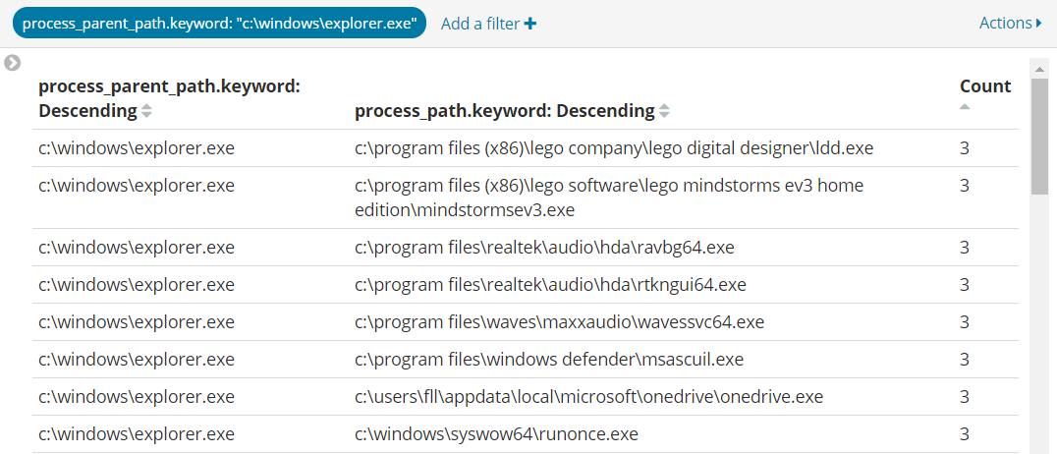
Stacking – Explorer
Notes:
Let’s take a look at a couple of stacking examples. Here we have a very small data set, but we are looking at all processes launched by Explorer – typically this is indicative of a user launching an application.

Slide 13
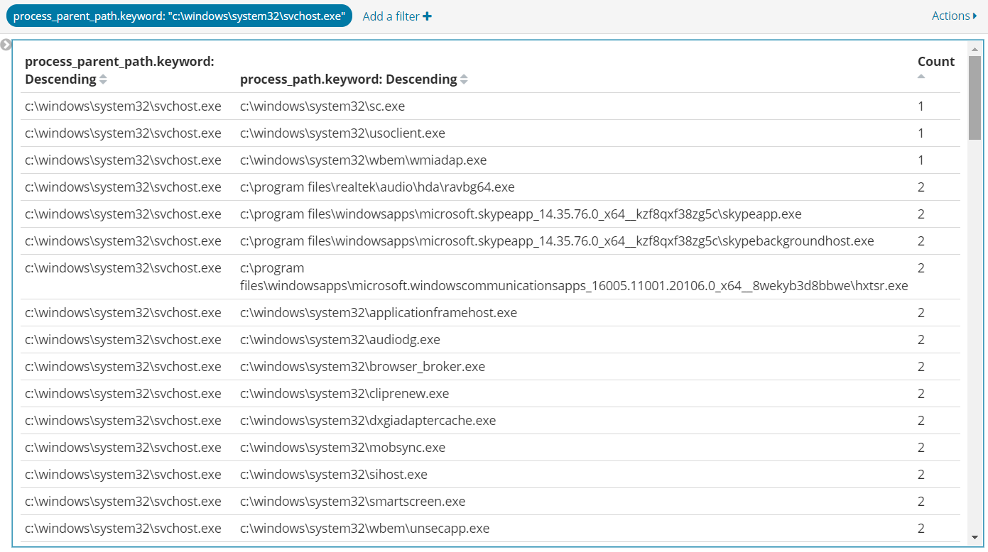
Stacking - svchost
Notes:
Same dataset; here we have all processes launched by svchost.

Slide 14
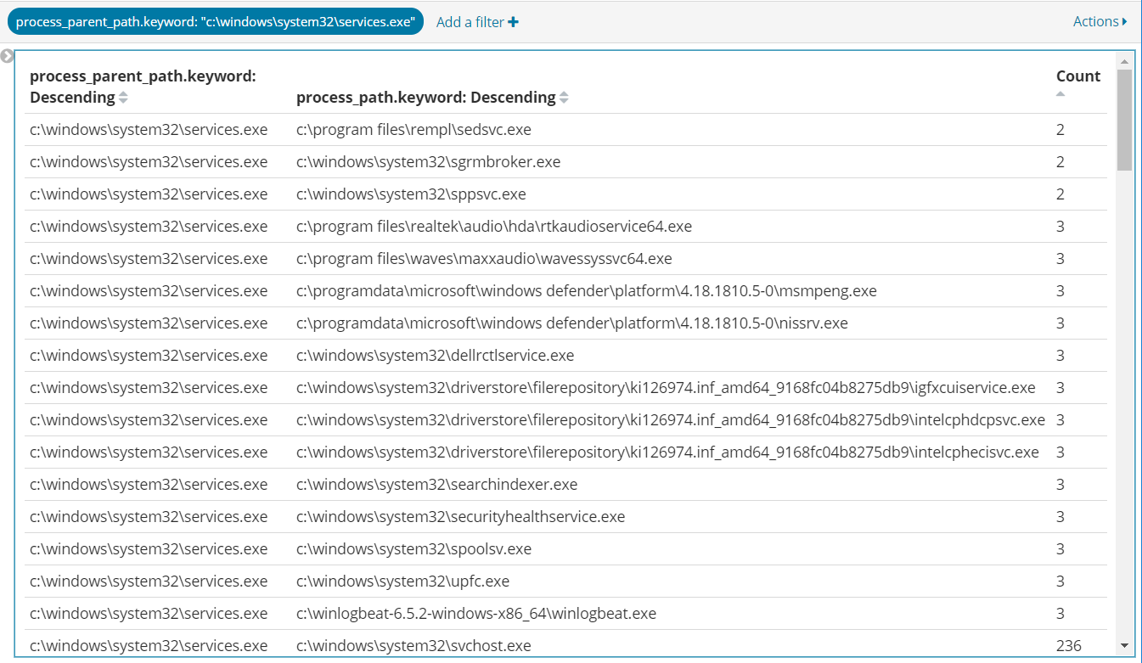
Stacking – Services
Notes:
Same dataset; here we are looking at all processes launched by services.exe – typically these are services.

Slide 15
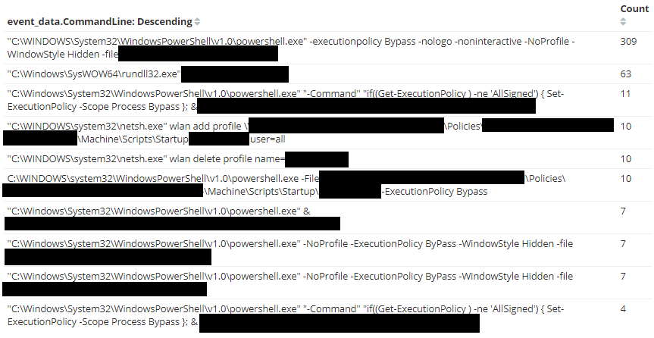
Suspicious Powershell
Notes:
Looking at a different dataset, here we have powershell activity using keywords like ‘hidden’ that might be suspicious

Slide 16
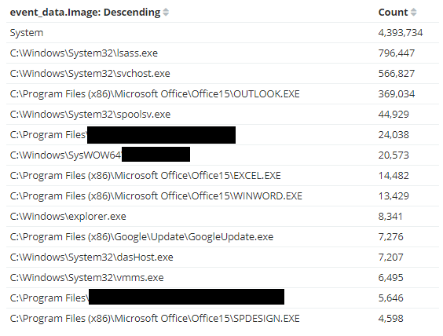
Sysmon – Network Activity
Notes:
Here we have an example of Sysmon’s network activity. This is a list of all applications opening network sockets

Slide 17
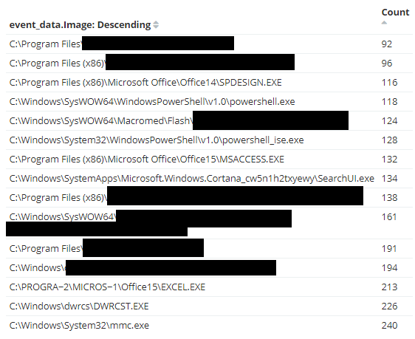
Sysmon – Network Activity Ascending
Notes:
Same dataset, but the order is now ascending

Slide 18
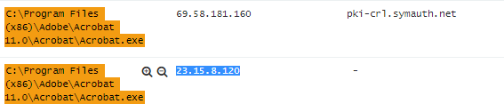

Acrobat – Network Connectivity
Sysmon – No Domain Name (uses reverse lookups)
Bro – Use dns.log to identify the domain
Notes:
Here we have an example of how centralizing all of the data can assist in incident investigations. While looking through the Sysmon network activity, we identified Actobat.exe with network connectivity. In digging deeper, we find that there is no domain name listed for the network activity. Therefore, we turn to bro which helps identify the traffic is destined for Akamai – a very large content distribution network. But more than that, we can see that the requested domain was an adobe domain that resolved to an Akamai IP. Reverse lookup on the IP address would have only given us an Akamai domain name.

Slide 19
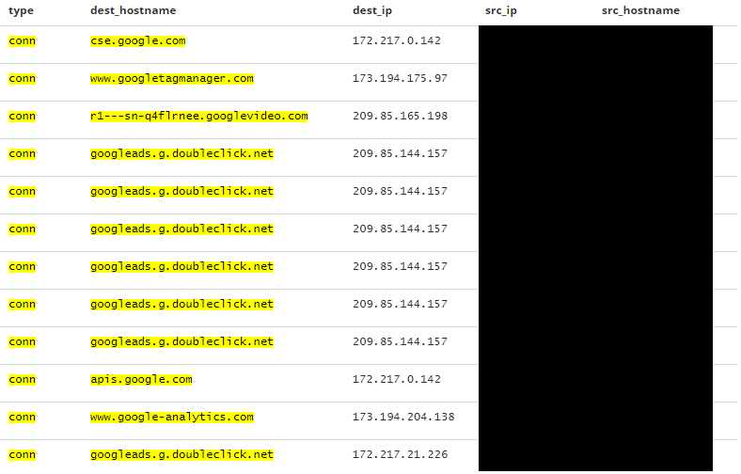
Enrichment
Notes:
Here is an example of how we can Enrich our datasets using available data. Bro conn logs do not include the domain contacted – this is primarily because they are two separate connections: a DNS request, and the follow-on connection (HTTP or otherwise). With a little work, we can combine this data. Additionally, since we have hostnames from Sysmon, we can append that data to the conn log record (or whatever record we desire). Now, if we want, we can do our analysis by hostname and no longer worry about DHCP changing the host we are analyzing! How much time could that save in an investigation if you had all the data immediately available?
The bottom line is the possibilities are endless; we just have to have the data available and work out which are the best options.

Slide 20
One More Thing…
Notes:
One more thing…

Slide 21
One More Thing…
Machine Learning
Notes:
As a parting gift. Machine Learning is the gift that keeps on giving. And the joy of centralizing logs means that machine learning becomes a possibility. It can be commercial, home grown, or whatever tickles your fancy. Centralizing you logging provides extensive value. And, if you really want to, you can even use it for operations.

Slide 22
Summary
Collect
Learn
Analyze
Notes:
First, collect your logs
Second, learn what “normal” is
Third, go find bad/weird stuff
Repeat 1-3
Finally, make the machines find stuff

Slide 23
Resources - Tools
https://github.com/Cyb3rWard0g/HELK
https://cyberwardog.blogspot.com/
https://docs.microsoft.com/en-us/sysinternals/downloads/sysmon
https://securityonion.net/
https://github.com/nsacyber/Event-Forwarding-Guidance/tree/master/Events
https://uncoder.io/

Slide 24
Resources – Videos
https://channel9.msdn.com/Events/Ignite/Australia-2015/INF327
https://www.irongeek.com/i.php?page=videos/bsidescolumbus2018/p05-the-quieter-you-become-the-more-youre-able-to-helk-nate-guagenti-roberto-rodriquez

Slide 25
Resources - Knowledge
https://www.andreafortuna.org/dfir/forensics/standard-windows-processes-a-brief-reference/
https://github.com/Cyb3rWard0g/OSSEM
https://attack.mitre.org/matrices/enterprise/
https://sqrrl.com/media/Framework-for-Threat-Hunting-Whitepaper.pdf
http://www.hexacorn.com/blog/category/autostart-persistence/
http://blogs.sans.org/cyber-defense/files/2014/07/Process_Hacker_SANS_Jason_Fossen.pdf
https://github.com/keydet89/Tools/blob/master/exe/eventmap.txt
https://youtu.be/7q7GGg-Ws9s
https://www.threathunting.net/reading-list
https://jpcertcc.github.io/ToolAnalysisResultSheet/

Slide 26
Resources - Validation
https://atomicredteam.io/
https://github.com/endgameinc/RTA
https://github.com/uber-common/metta
https://github.com/mitre/caldera

